Slide 1
Breakdown of Case Study

Slide 2
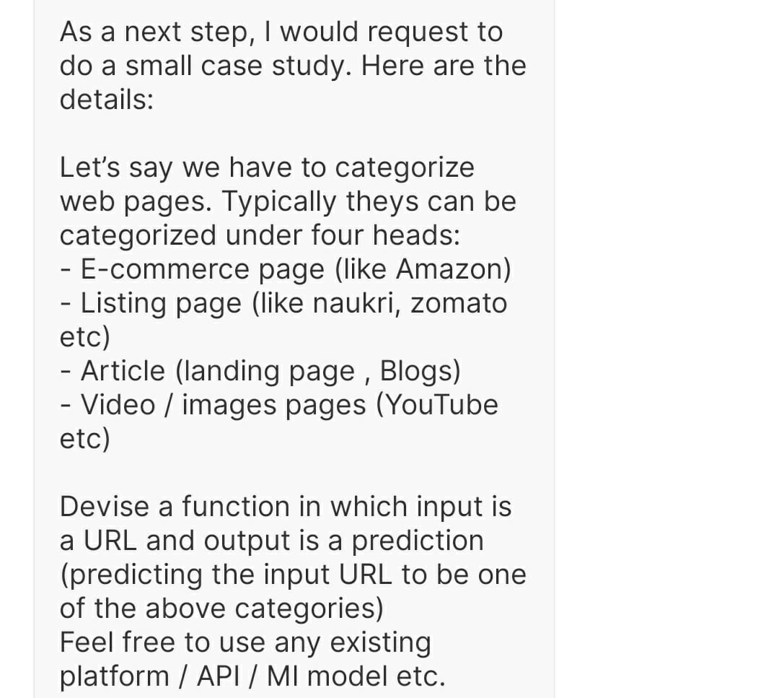
Problem Statement

Slide 3
First Step
Finding a list or dataset of URLs in the internet if available.
I found a dataset containing list of URLs and some of its category.
I formatted the dataset and made changes to it to make it in accordance to the problem statement
Since the problem stated I only needed 4 categories to classify websites. So changes were made in dataset labels accordingly to fit my purpose.

Slide 4
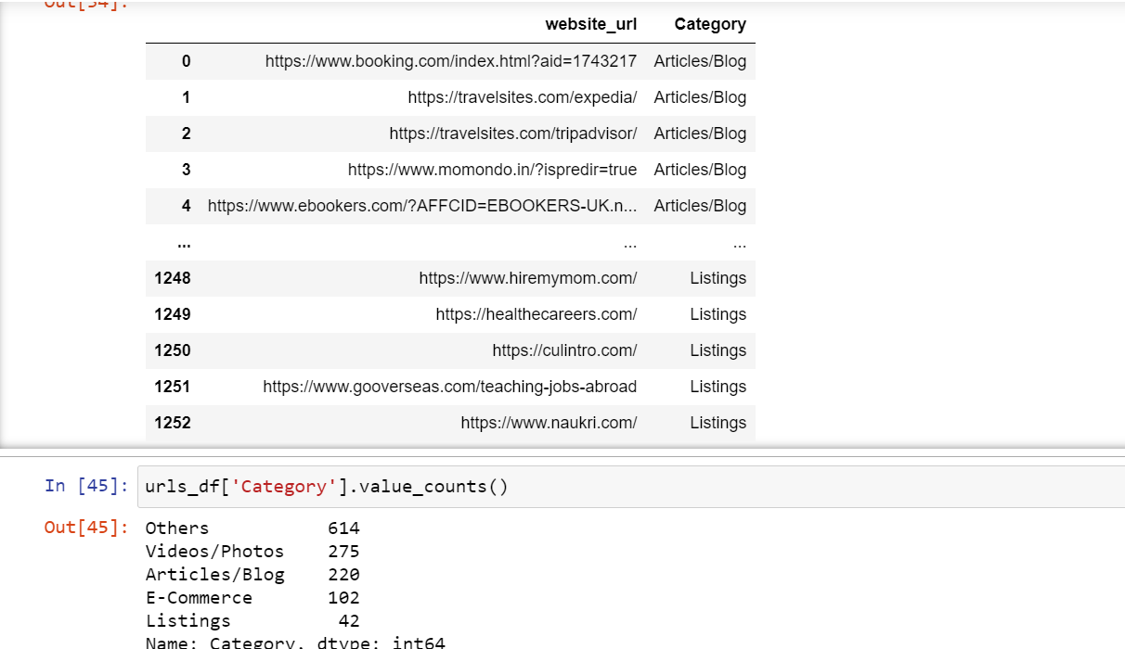
A view of Initial Dataset

Slide 5
Breakdown of each category
Articles/Blog | Photos/Videos | E-commerce | Listings | Others
Blogs Forums Travel Food Health or Fitness | Streaming Services Photography Social Networking | Shopping related | Jobs related | Sports Games Educational Technical News Business Adult
The table shows types of websites in each categories.

Slide 6
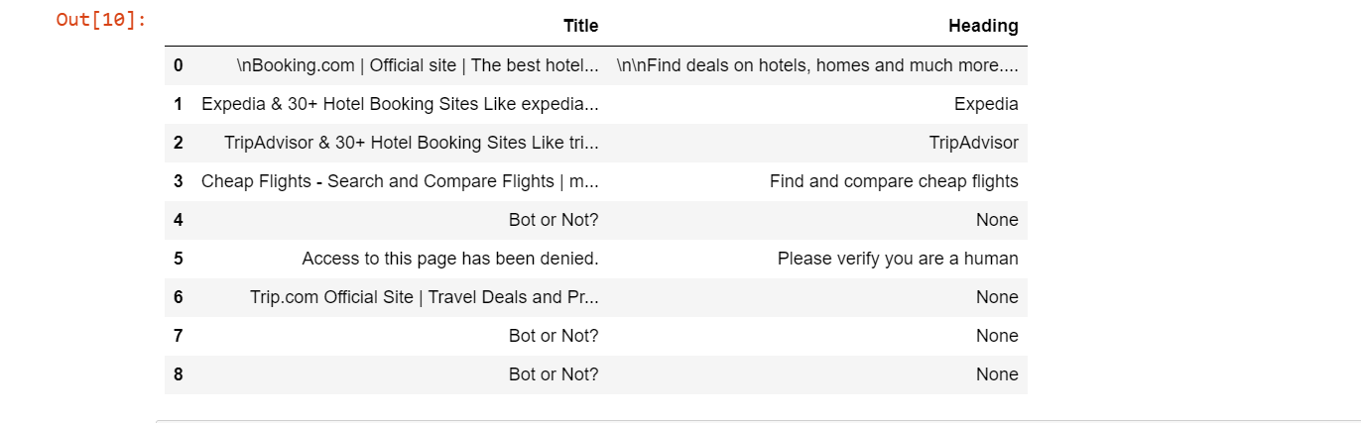
Second Step: Gathering information about each URLs
Scraping titles from each URLs using beautifulsoup model in python.
PROBLEM:
Too many NaN values because website treated it as a bot.

Slide 7
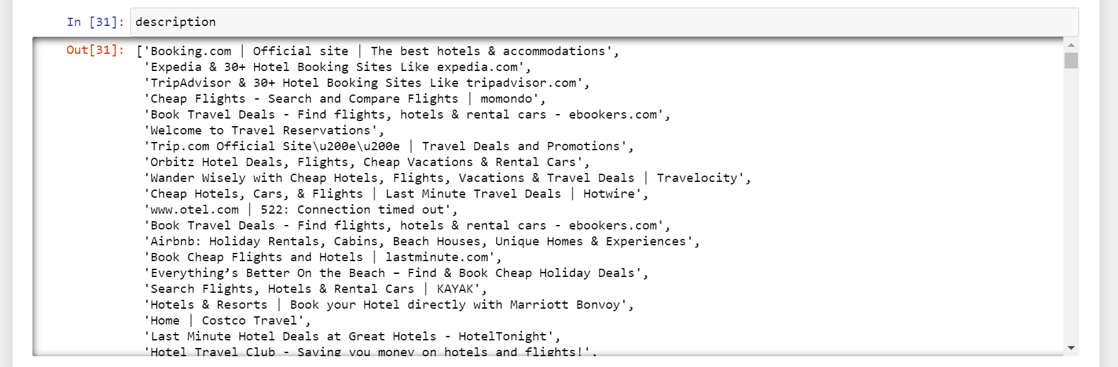
Revised Step 2: Using Selenium
Scraping title/description of each URL by selenium model of python.
This code loop ran for 14 hours to complete all the websites and extract the information.

Slide 8
Step 3: Combining the descriptions and Cleaning
Cleaning of description before feeding into the model
Unnecessary characters dumped.
Verbs simplifed

Slide 9
Step 4: Vectorization and Modelling
The corpus is vectorized and then fed to the models.
Models checked are :
Random Forrest Classification
Linear SVC
Non-Linear SVC (RBF)
Multinomial Naive Bayes
Gaussian Naïve Bayes

Slide 10
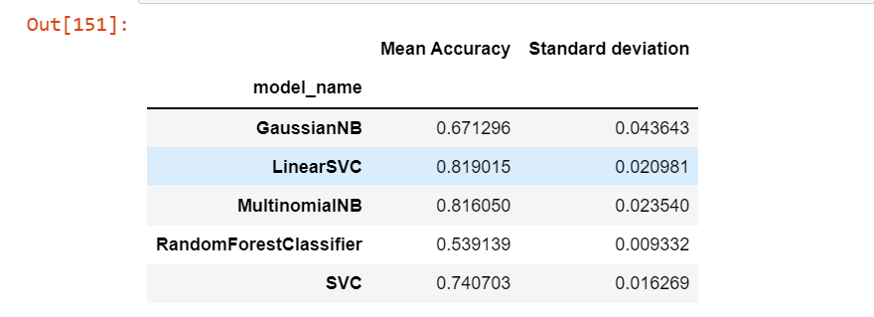
Approximate Results

Slide 11
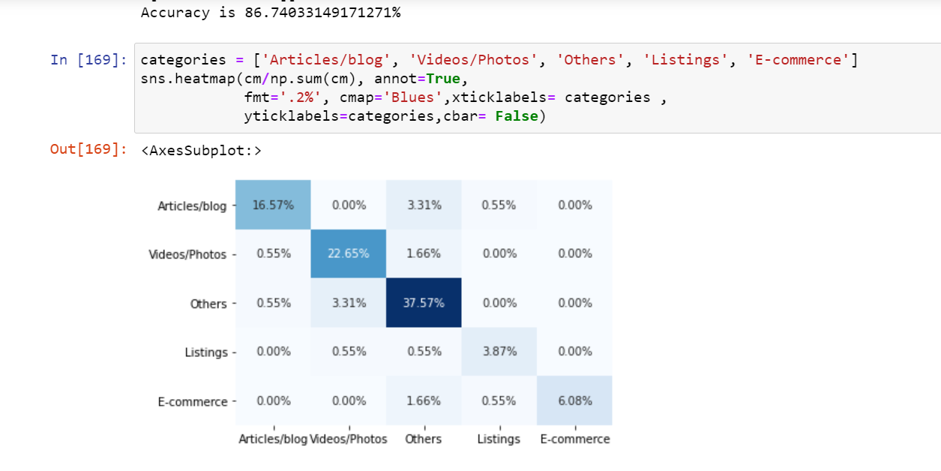
Final Result
Confusion Matrix

Slide 12
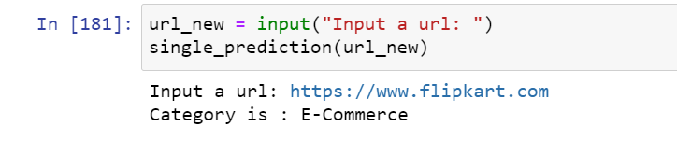
Making A Single Prediction

Slide 13
Thank You

